Slide 1
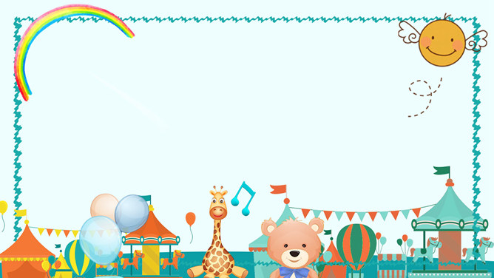
Chapter 2 Festivals we like
vocabulary (16-26)

Slide 2
Please take out your vocabulary book and turn to page 4.

Slide 3
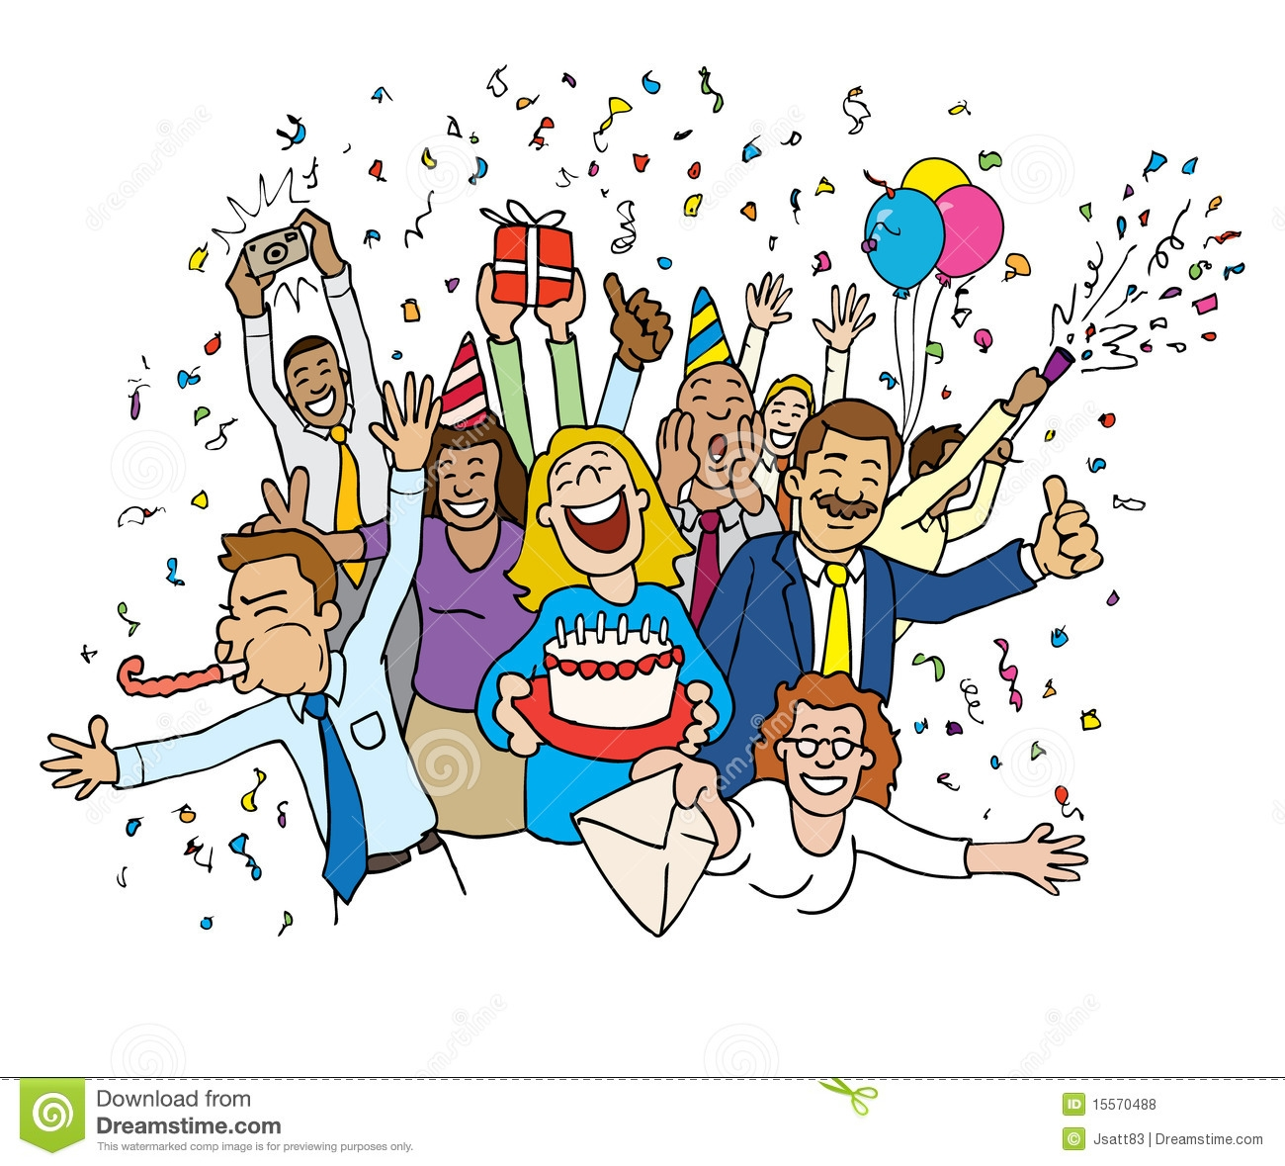
16. celebration

Slide 4
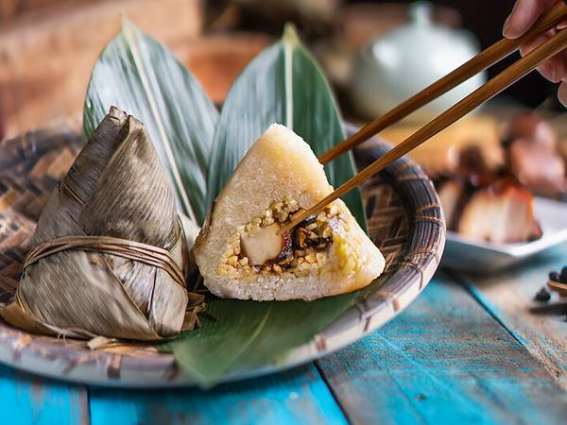
17. rice dumplings

Slide 5
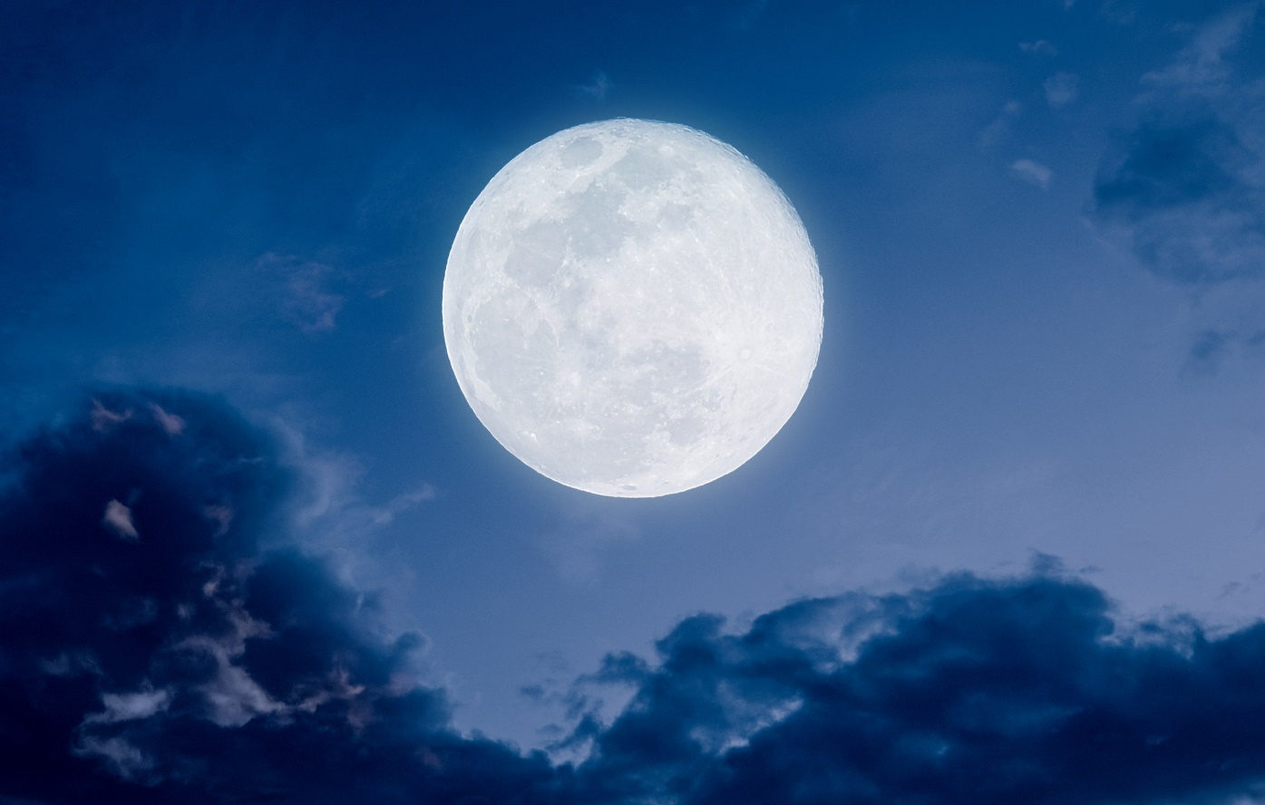
18. full moon

Slide 6
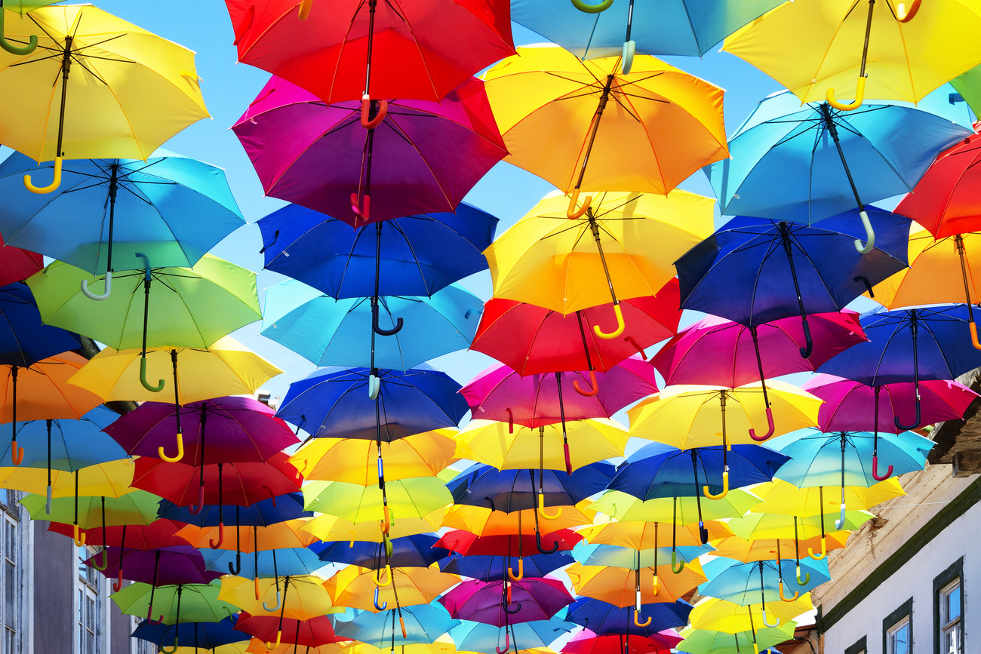
19. colourful

Slide 7
20. best

Slide 8
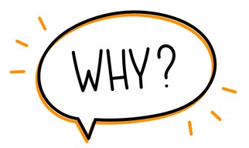
21. why

Slide 9
22. because
It is because…..

Slide 10
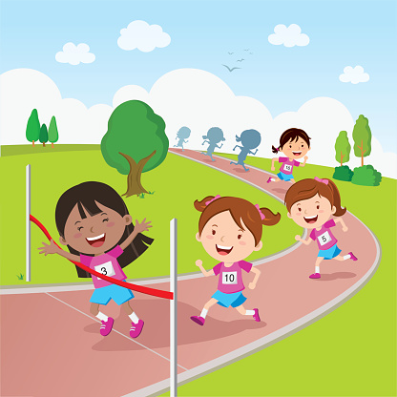
23. race

Slide 11
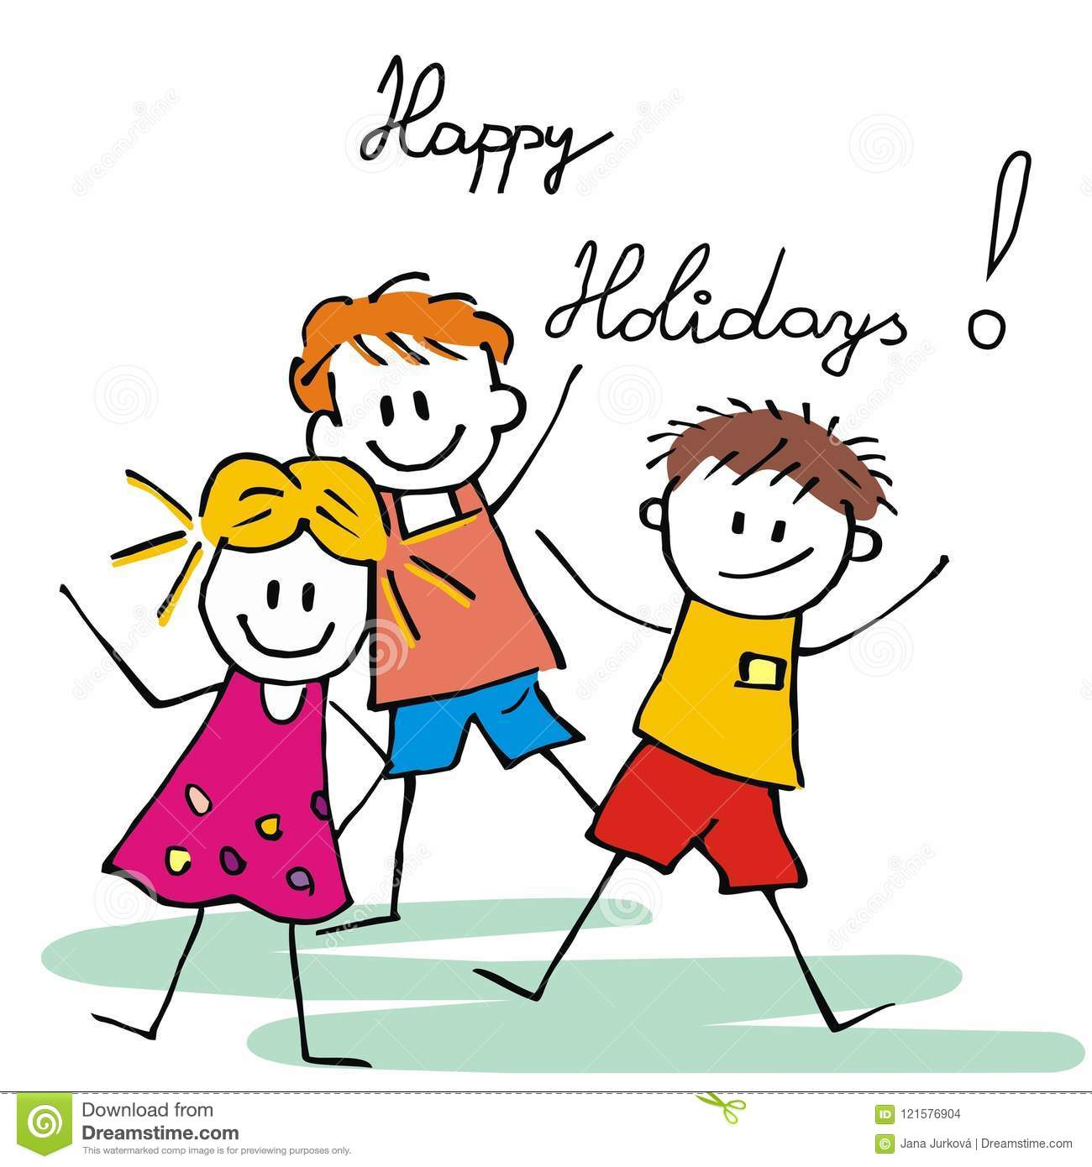
24. happy holidays

Slide 12
25. always

Slide 13
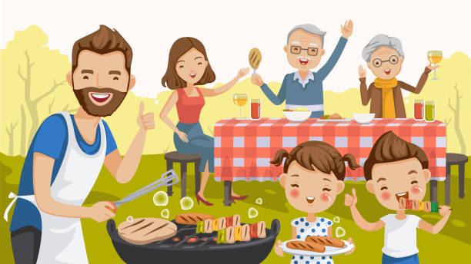
26. barbecue

Slide 14
Chapter 2 Festivals we like - vocab (16-26)
16. celebration 慶祝活動 | 22. because 因為
17. rice dumplings 粽子 | 23. race 比賽
18. full moon 滿月 | 24. happy holidays 節日快樂
19. colourful 色彩繽紛的 | 25. always 常常
20. best 最 | 26. barbecue 燒烤
21. why 為什麼

